Slide 1
Unit 1: Anatomy and Physiology
Learning aim A

Slide 2
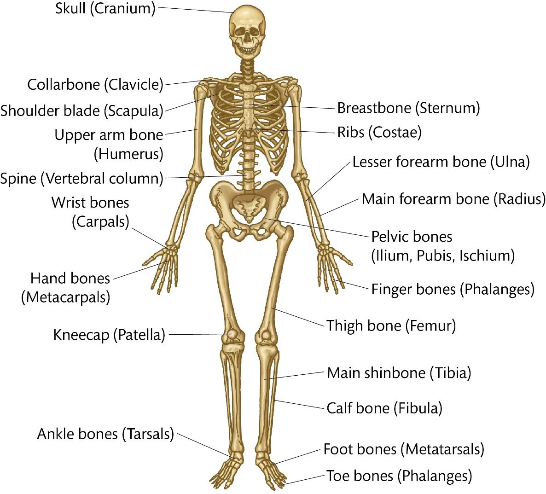
Structure of the skeletal system

Slide 3
Types of bone
Long bones
Short bones
Flat bones
Irregular bones
Sesamoid bones
e.g. femur
e.g. carpals
e.g. sternum
e.g. spinal vertebrae
e.g. patella

Slide 4
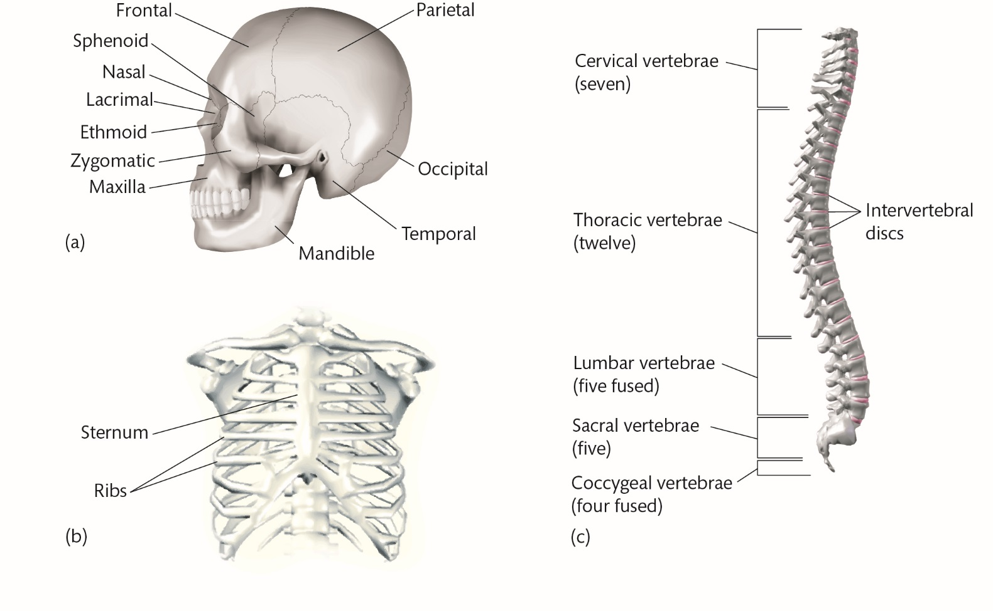
The axial skeleton

Slide 5
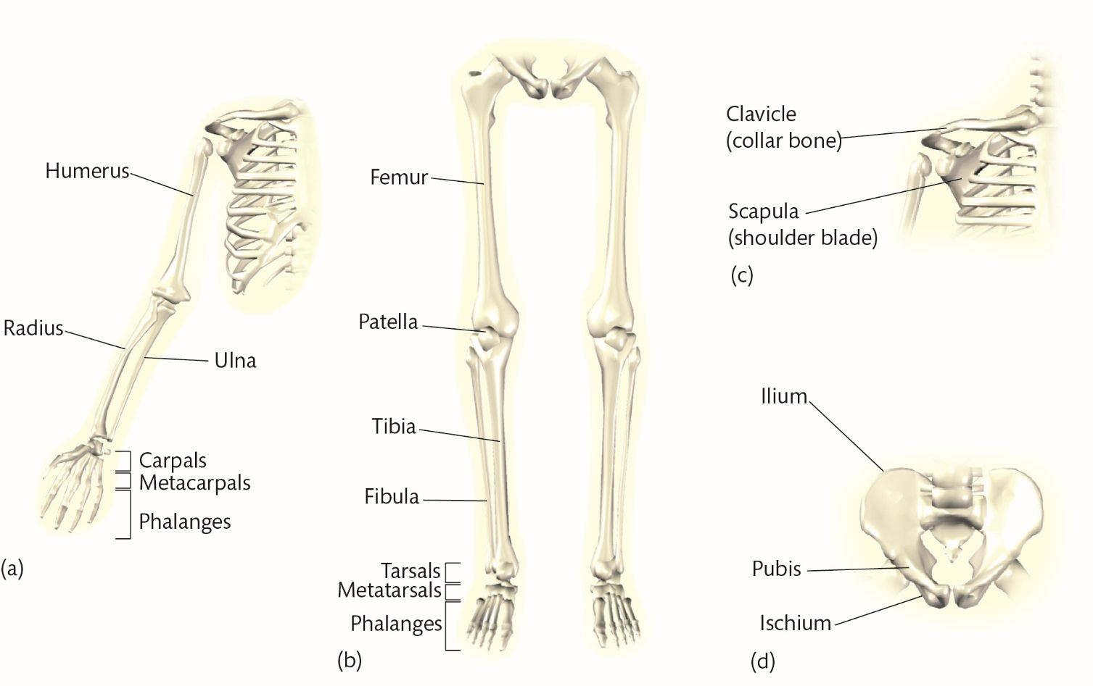
The appendicular skeleton

Slide 6
Spine (vertebral column) (1)
Extends from base of the cranium to the pelvis
Provides a central axis for the body
Made up out of 33 irregular bones (vertebrae)
Makes up 40% of person’s overall height
Held together by powerful ligaments allowing little movement between adjacent vertebrae but a great deal of flexibility across the spine

Slide 7
Five main regions of the spine
Cervical – 7 vertebrae of the neck, forming a pivot joint for the head
Thoracic – 12 vertebrae of the mid-spine, articulating the ribs
Lumbar – 5 largest vertebrae in the lower back, supporting weight
Sacral – 5 vertebrae fused together to form the sacrum, the back wall of the pelvic girdle
Coccygeal – 4 vertebrae at the bottom forming the coccyx

Slide 8
Functions of skeletal system
Supporting framework
Protection
Attachment for skeletal muscle
Source of blood cell production
Minerals store
Leverage
Weight bearing
Reducing friction across a joint

Slide 9
Fixed and slightly moveable joints
Fixed joints
Do not move
Form when bones interlock and overlap during childhood
Held together by tough, fibrous tissue
e.g. bone plates in the cranium
Slightly moveable
Allow slight movement
Bone ends covered with smooth, shining covering (articular cartlidge)
Bones separated by pads of white firbrocartlidge which compress to allow movement

Slide 10
Synovial joint structure

Slide 11
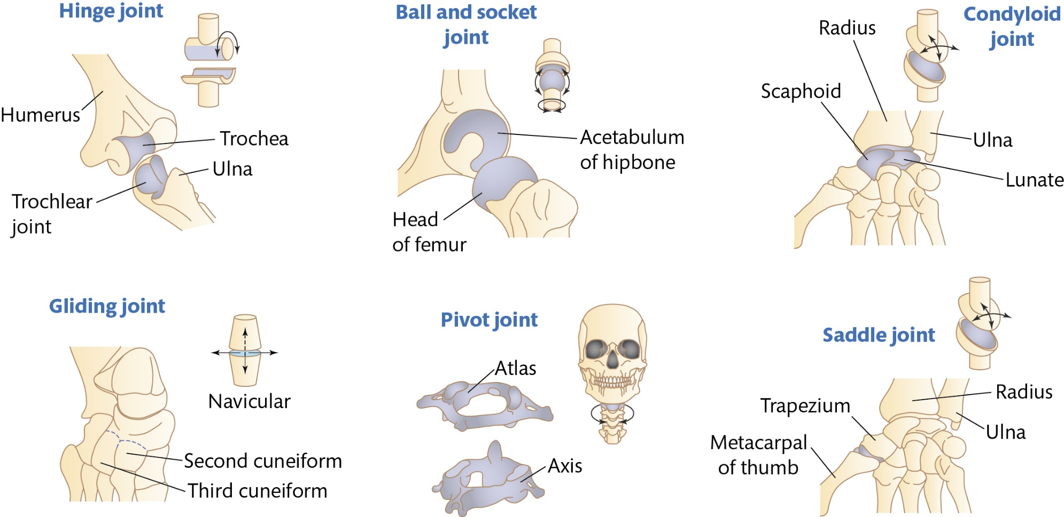
Types of synovial joint

Slide 12
Responses of skeletal system to a single sport session:
Increase in mineral uptake within bones due to weight-bearing exercises
Adaptations of skeletal system to exercise:
Increased bone strength
Increased ligament strength

Slide 13
Additional factors affecting skeletal system
Arthritis
Inflammation within a synovial joint
Osteoporosis
Weakening of bones caused by a loss of calcium or a lack of vitamin D
Age
Putting too much force on a child's bones can damage the epiphyseal plates, causing stunted growth

