Slide 1

Why Educate?

Slide 2
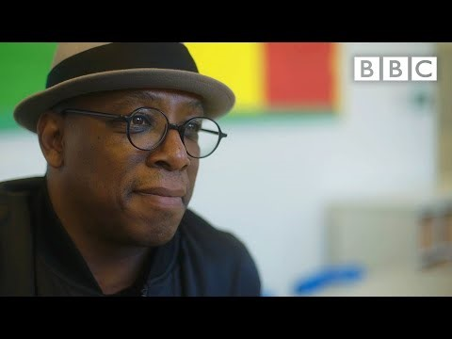
Be an Educator who changes lives
^{Why Educate?}

Slide 3
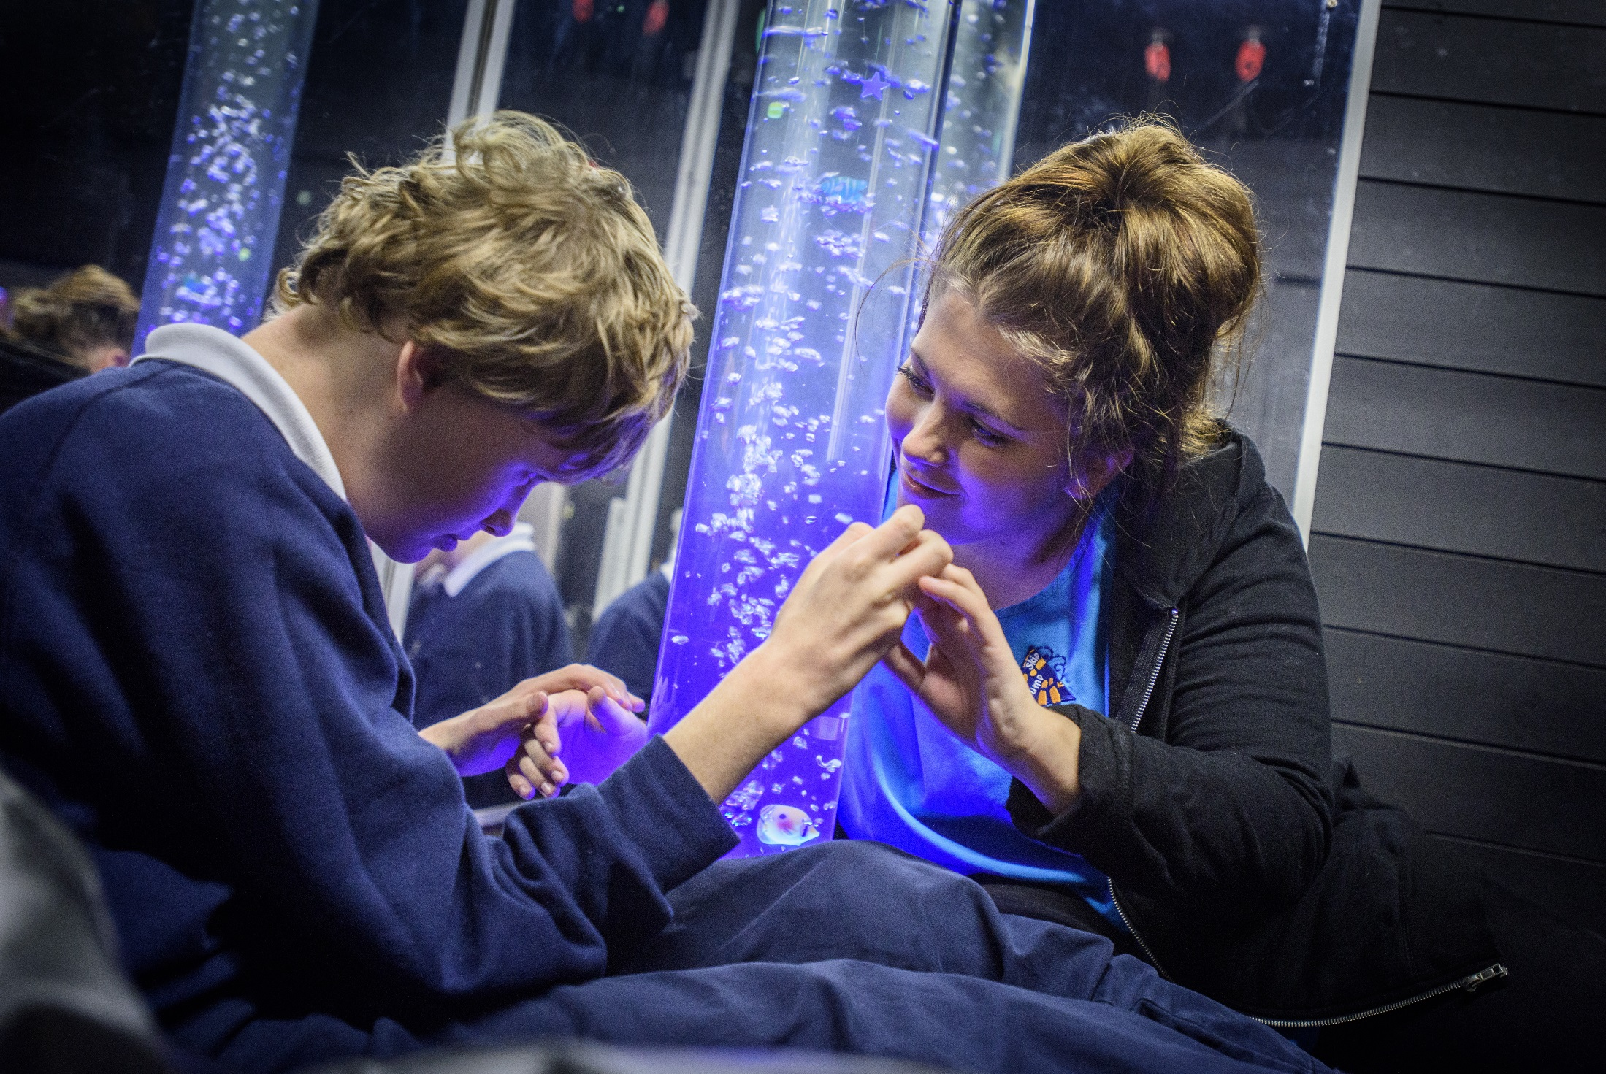
Changing lives through:
Community
Society
Government
Educational Settings
^{Why Educate?}

Slide 4


Careers in Education
Ofsted Inspector
Trainer
Museum Gallery Educator
Teacher
Speech Therapist
Events Manager
Policy Advisor
Youth & Community Officer
Education
Welfare Officer
Education Psychologist
Subject Advisor
Outward Bound
Child Protection
Officer
^{Why Educate?}

Slide 5






The education of young people in conflict with the law – a way to social justice
3 Erasmus funded projects
Plus new research under way to understand the challenges of working and researching with transnational partners and settings which are closed and participants hard to reach.
Prison Mentor
Dr Adeela Ahmed Shafi MBE
Associate Professor in Education
^{Why Educate?}

Slide 6
Outreach
Arranging subject taster activities to take place at universities or in schools
Providing impartial guidance to students on their next steps after school or college
Work with students from Years 7-13
Outreach work is completed by universities and colleges across the UK
Focus on Access and Widening Participation
Organise a range of activities and events, designed to help raise students’ aspirations, ambitions and awareness of higher education.
www.glos.ac.uk/ outreach
Ensuring that all students can access their studies, regardless of socioeconomic background, ethic group, disability or age.
^{Why Educate?}

Slide 7
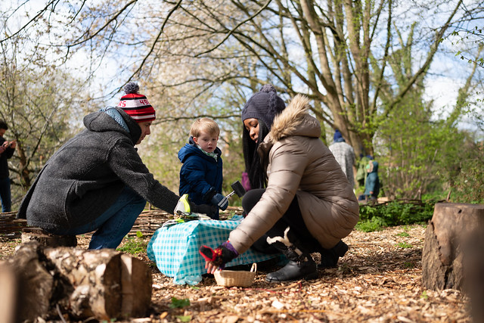
BA Hons Early Childhood Studies
Mental Health Well-being
Education & Special Needs
Health & Social Care
Psychology
Sociology
Family Studies
Media Studies & Politics
Graduate Practitioner Status
Multi-disciplinary & Inter-disciplinary
https://www.youtube.com/watch?v=9YQnP8Lgdas
^{Why Educate?}

Slide 8
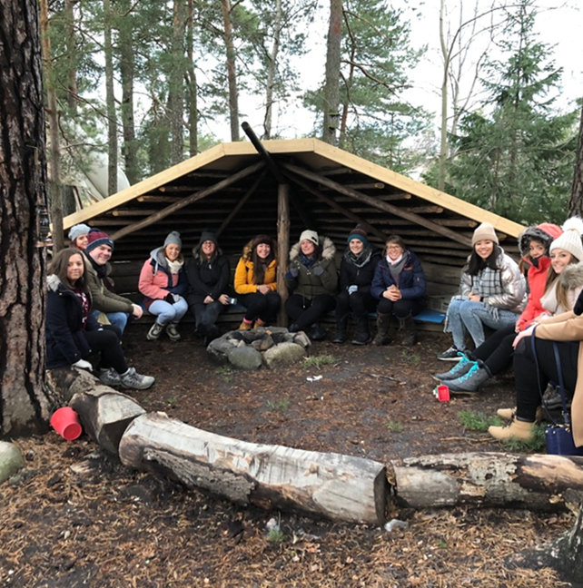
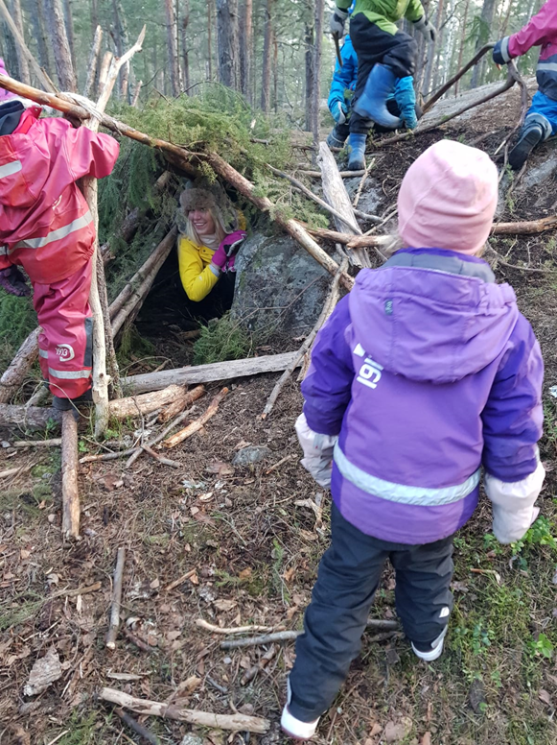
International Trip to Stockholm,
Sweden
Unique
Thought-provoking
Transformational
^{Why Educate?}

Slide 9
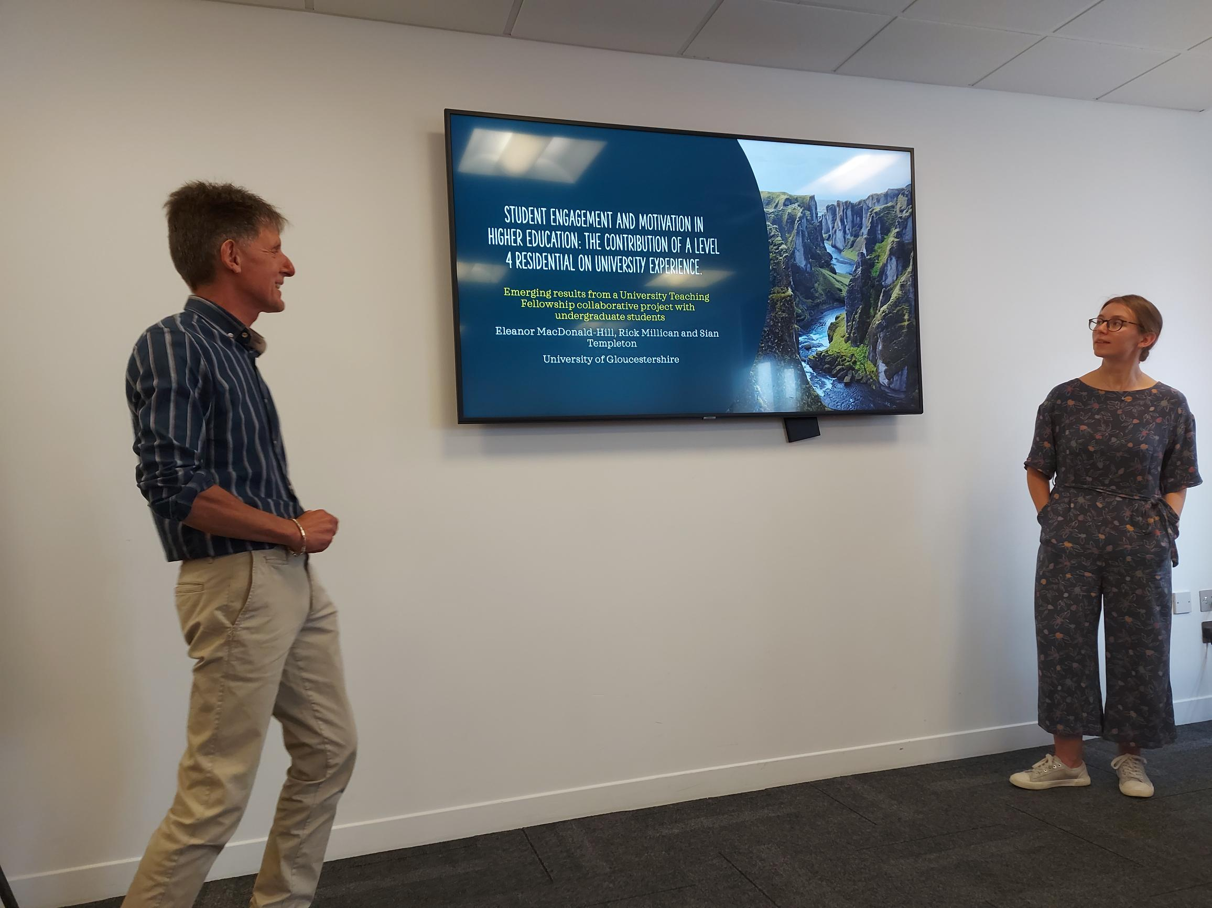
BA (Hons) Education
Global issues of Inequality in Education
Sociological & Psychological Perspectives in Education.
Sustainability and Social Justice.
Community Development.
Learning Outside the Classroom
Education for Change
^{Why Educate?}

Slide 10

BA (Hons) Education, Inclusion and SEN
Placements
Residential Experiences National & International
Changing Societies and Disability
Education in an Ethically Diverse Society
Education & Society around the world
TEFL
Educational Psychology
Contemporary Issues in Education
^{Why Educate?}

Slide 11
Interaction
Progression
Why Teach?
Starting Salary
Training
^{Why Educate?}

Slide 12

Primary Education - Billy
^{Why Educate?}

Slide 13

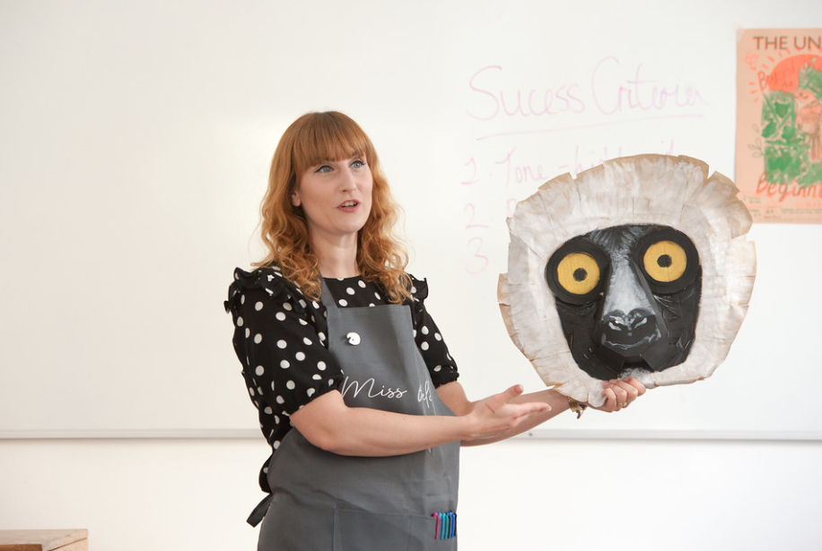
Lisa Field, PGCE Secondary Art and Design Graduate
Prize Winner of the Old Students’ Association Award
‘All the lecturers of the PGCE in Secondary have so much knowledge and expertise, which is expelled through a supportive and kind demeanor. They also encourage independent thinking whilst being empathetic to any gaps in learning we have.’
^{Why Educate?}

Slide 14


Our Courses
BA Early Childhood Studies
PGCE in Primary and Secondary
BA Education, Inclusions & SEN
BEd Primary Education (QTS)
BA Education
^{Why Educate?}

Slide 15
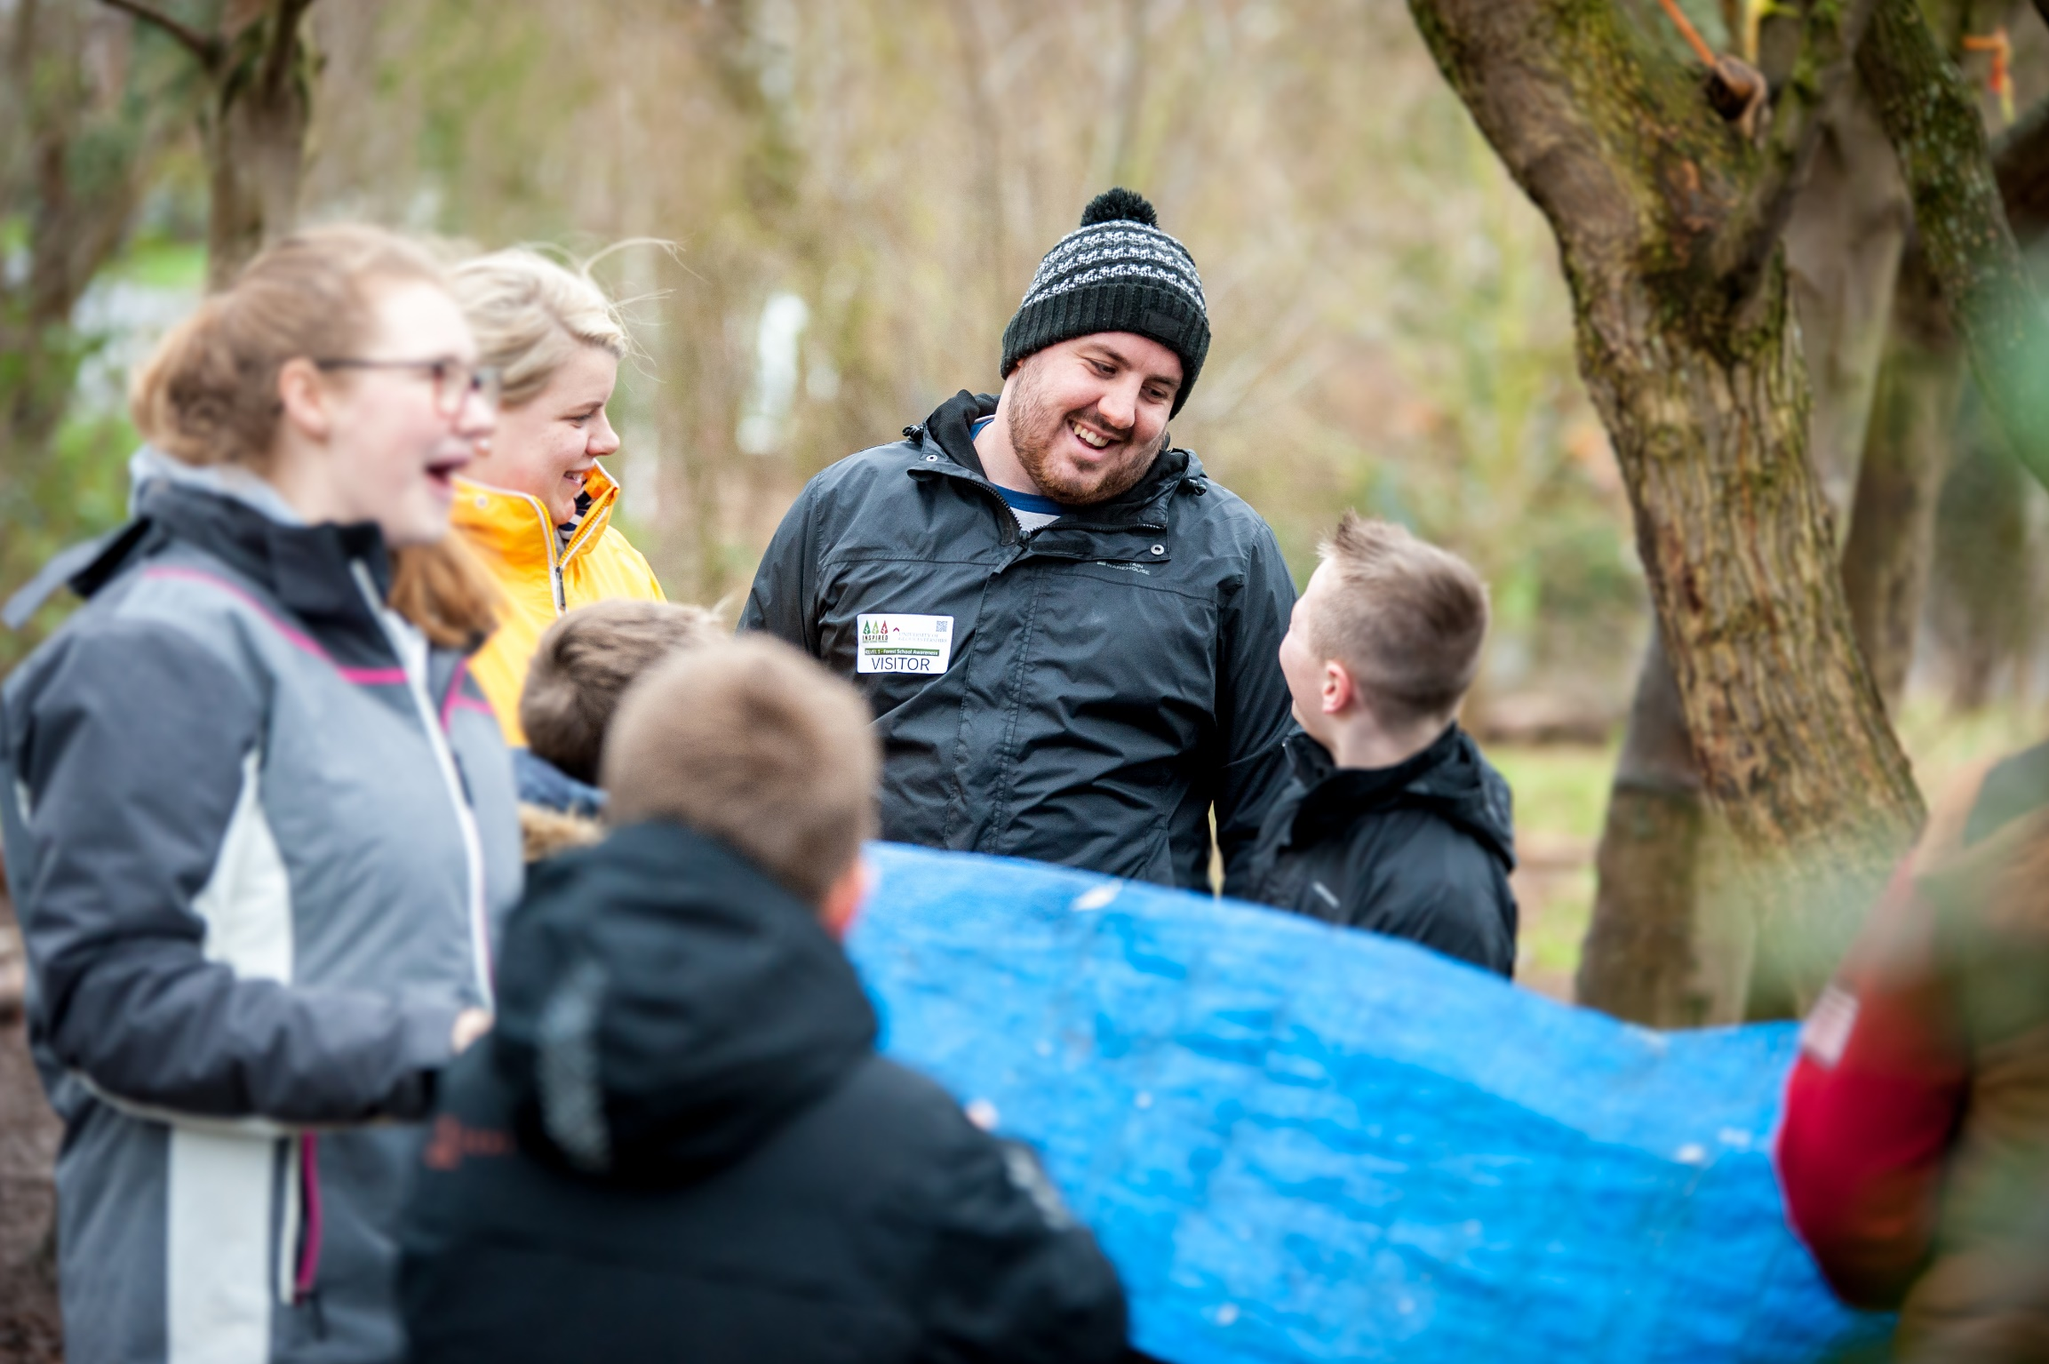
International Trips
Residentials
Employment
Forest School
Sustainability for Education
Work Placements
Pastoral Care
Research Informed
Professional Qualifications
Student Union Societies
^{Why Educate?}

Slide 16
Find Your Why
^{Why Educate?}

Slide 17
Application Process:
Education Courses
Interviews
Personal Statement
UCAS
^{Why Educate?}

Slide 18
Application Process:
Education Courses
Interviews
Personal Statement
UCAS
^{Why Educate?}

Slide 19
Application Process:
Interviews
Group Presentation
Interview Panel
Group
Tasks
^{Why Educate?}

Slide 20
What do I need to demonstrate?
Skills
&
Knowledge
Current
Issues
Experience
Confidence
^{Why Educate?}

Slide 21
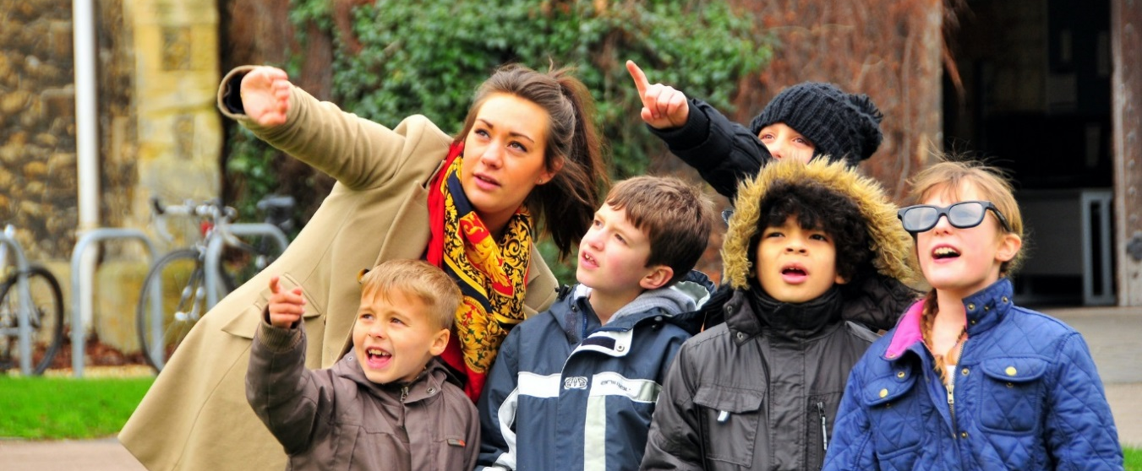

Any Questions?
Start your journey
Change lives through Education……….
At the University of Gloucestershire
^{Why Educate?}

Slide 22

Tell us what you think…
Outreach online evaluation form
QR code or link –bit.ly/uogout
Activity ID - #683522
Notes:
We have a short online evaluation form, which we would really appreciate if you could complete now. It should only take a couple of minutes and allows you to feedback on today. You can either follow the short link or use the QR code and you will be asked for the activity ID – which is found on this slide.
*FYI – doesn’t need to be read to the students*
The University of Gloucestershire takes the collection and use of personal data very seriously and is committed to processing personal data in accordance with the General Data Protection Regulation and Data Protection Act 2018.
The University’s outreach programme is funded by the Government. The information you provide will be held securely and used by the University in connection with your participation in our outreach programmes and in order to track your progression from school into Further and Higher Education.
We may use some of the data in research, reports and publications anonymously but we would not publish your name or personal details to allow you to be identified from the data in any such reports or publications.
The University will only share your data with other authorised organisations and it will not be released to unauthorised individuals or organisations. Our Privacy Notice will tell you how we collect and use your personal data, a copy is available at http://bit.ly/StudentPrivacyNotice.
HEAT Privacy Notice: https://heat.ac.uk/data-privacy-participants/

Slide 23
Outreach evaluation forms
Data protection
WHY?
Outreach is government funded and we have a ‘public task’ to show how well we meet our goals.
HOW?
Personal data is always kept safe, confidential, and secure in HEAT (Higher Education Access Tracker) database.
WHAT?
We provide information for government reports, research, publications, and presentations.
WHO?
Reports will never identify you specifically. No names are ever used.
The University of Gloucestershire takes the collection and use of personal data very seriously and is committed to processing personal data in accordance with the General Data Protection Regulation and Data Protection Act 2018.
We are interested in tracking your studies so we can see if our activities are effective in helping you make choices about university.
The University will only share your data with authorised education-related organisations (so we can see where you study). With your permission, we keep your information for up to 15 years after you graduate unless you tell us otherwise.
Our Privacy Notice will tell you how we collect and use your personal data; a copy is available at: http://bit.ly/StudentPrivacyNotice.
You choose how much information to fill in.
It’s easy to let us know if you no longer wish to be involved. Just email us before the end of the school year, or before you finish your studies: outreach@glos.ac.uk
^{Why Educate?}
Notes:
The University of Gloucestershire takes the collection and use of personal data very seriously and is committed to processing personal data in accordance with the General Data Protection Regulation and Data Protection Act 2018.
The University’s outreach programme is funded by the Government. The information you provide will be held securely and used by the University in connection with your participation in our outreach programmes and in order to track your progression from school into Further and Higher Education.
We may use some of the data in research, reports and publications anonymously but we would not publish your name or personal details to allow you to be identified from the data in any such reports or publications.
The University will only share your data with other authorised organisations and it will not be released to unauthorised individuals or organisations. Our Privacy Notice will tell you how we collect and use your personal data, a copy is available at http://bit.ly/StudentPrivacyNotice.
HEAT Privacy Notice: https://heat.ac.uk/data-privacy-participants/

