Slide 1
personal Statements
2022-23

Slide 2
What evidence do universities look for in an application?
Qualification requirements are met
Predicted grades are acceptable
You have genuine interest in the course
You’ll be able to cope with the course
So what’s taken into account?
Past and predicted performance (main form and reference)
Focus, motivation, interest, passion for the subject
Evidence of reasoning ability and inquisitiveness
Evidence of independence and critical thinking
The last three points are sought in your personal statement.

Slide 3
Personal Statements
Watch this video that covers the UCAS process and personal statements made by Aston University and replaces the material that I would normally talk through in this presentation https://www.youtube.com/watch?v=qtZqZIxZ6kY
Look at this UCAS web page that helps you get started
https://www.ucas.com/ucas/undergraduate/getting-started/when-apply/how-write-ucas-undergraduate-personal-statement

Slide 4
What admissions tutors are looking for
Independent study skills
Self-awareness
Motivation and commitment
An understanding of the course
Good numeracy and literacy
Essay writing
Research skills
Time management skills
Enthusiasm to go beyond the syllabus
Notes:
This is not an exclusive list and individual institutions will have specific criteria for specific courses

Slide 5
Personal Statement ABC Guide
Good
Better
Best
What you’ve done
What skills it has given you
How these relate to your course
Activity
Benefit
Course
Notes:
Good personal statements will give information about what activities you have been involved with.
Better personal statements will then develop these activities into sentences that show what skills have been gained through these activities.
The best personal statements will take these developed statements and show how the specific activities and skills gained are related to the course they wish to undertake.
Research into courses is essential to make the highest level personal statements possible.
This can be used as an exercise – students can write out

Slide 6
Reasons given to unsuccessful applicants
“
Unsuccessful as you have not expressed a strong enough interest in the subject area in your personal statement
You failed to demonstrate sufficient knowledge and interest in the subject in your personal statement
”
Your personal statement did not show sufficient understanding, relevance or knowledge about the course you are applying for
Your personal statement does not strongly support your desire to study your chosen degree
Notes:
These four examples are taken from data given in 2010 to applicants as reasons for being made unsuccessful

Slide 7
Personal Statement: Do’s & Don’ts
Do’s
Mention future aspirations
Get feedback from others
Advisers
Parents / Guardians
Write it early and edit
Take it with you to interview
Be prepared to answer questions about it
Don’ts
Intellectual pretensions
Misdirected humour
Plagiarism
Mentioning one institution
Committing GBH on English language
‘I so don’t want to miss this opportunity’
‘It was a catch 12 situation’
Notes:
Further guidance can be found here: http://www.ucas.ac.uk/students/applying/howtoapply/personalstatement/dos

Slide 8
Edit, edit, edit!
Notes:
If you don’t check your work you’ll end up feeling like these guys who have just realised they’ve painted the word Shcool instead of School!

Slide 9
Punctuation
Same words same order but punctuation…
Dear John: I want a man who knows what love is all about. You are generous, kind, thoughtful. People who are not like you admit to being useless and inferior. You have ruined me for other men. I yearn for you. I have no feelings whatsoever when we are apart. I can be forever happy – will you let me be yours? Gloria
Dear John: I want a man who knows what love is. All about you are generous, kind, thoughtful people, who are not like you. Admit to being useless and inferior. You have ruined me. For other men, I yearn. For you I have no feelings whatsoever. When we are apart, I can be forever happy. Will you let me be. Yours, Gloria
Notes:
The words stay exactly the same – spellchecker could not help you here – yet the meaning is entirely different!

Slide 10
Do not go over the top…
… and when I’m not working towards World Peace, I enjoy learning languages from scratch, writing symphonies and playing a standard of golf that Tiger Woods can only dream about.
Notes:
Credibility is incredibly easy to loose.

Slide 11
REMEMBER: Similarity Detection Service
Personal Statements are checked against a library of those already in the system, and from a variety of websites and paper publications
Each new statement is added to the library every year!
You are saying it is all your own work when you enter it into the form.
A copy of everything plagiarised is highlighted and sent to each university you apply to if found, it won’t look good to the admissions tutor!
Notes:
The pop up banner is from the personal statement section on Apply 2012. All applicants should be aware of this.

Slide 12
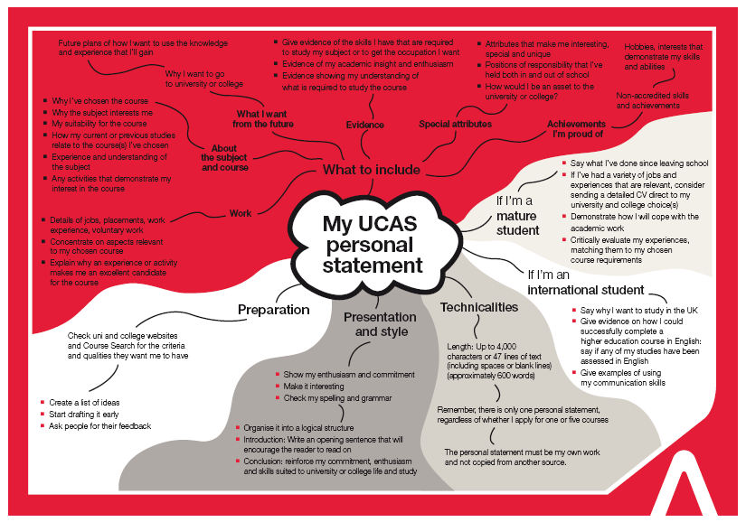
Exercise: Personal Statement Mind Map
Notes:
Hand out copies of this Mind Map and encourage students to choose a section and start writing out some personal information to put into a draft statement.
If there are sections they are struggling on then this can give an indication where additional research needs to be taking place – for example ‘about the course’ or ‘what I want from the future’.

Slide 13
What you should have done and still be doing now?
Researched the course entry requirements and gained relevant work experience if it is required
Do extra curricular activities and go beyond the syllabus
Started all sections of the UCAS form except the statement and course choices.
Work on first draft of Personal Statement!!

Slide 14
Video Links
https://www.unitasterdays.com/ondemand/webinar/58/personal-statements - A good up-to-date on demand webinar that splits the information between three different areas and delivered by three different universities.
https://www.youtube.com/watch?v=5jQ3MJgdkJY&feature=youtu.be&list=PL2SyLaSjZODmkfy2uZa0I_zT3AIZqdjiK – This is a great video to highlight the good and bad ways to write your statement and I still highly recommend it as even though made in 2011 it is totally relevant to applications now!
https://www.youtube.com/watch?v=JWxFVtSUAsQ&feature=youtu.be – A good insight into what admissions tutors are looking for.

Slide 15
To do now and in the next three weeks…
Read the excellent “Personal Statement Guide” – Essex University
Read individual university websites and the course information to personalise towards the course applied for (careful not to make one university obviously stand out)
Complete the “Improving a Personal Statement” Tasks 1-4 and take your time to do them properly in order rather than skip through them
Use the Oxford Masterclass Personal Statement log in details to set up and work through the material at your own pace to come up with a first draft of your own personal statement

