Slide 2
Registering for a UCAS Hub account.

Slide 3
Registering for an account
Head to ucas.com
Select Sign in from the drop-down menu.

Slide 4
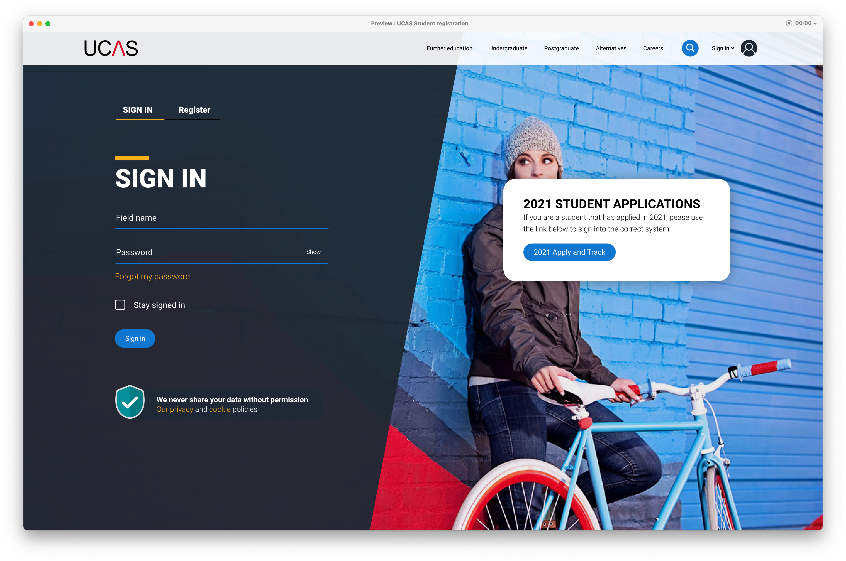
Registering for an account
Choose Register.
Note: The design of this screen is likely to change slightly through the application cycle.

Slide 5
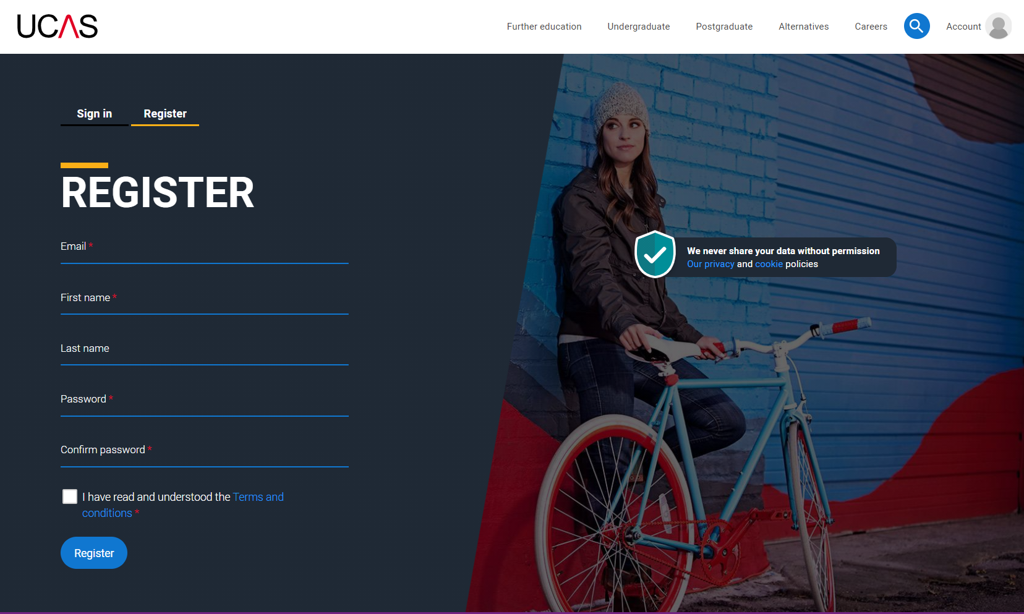
Registering for an account
Complete the short form.
Make sure the password is memorable.
Recommend school email address and school login – needs capital, lower case, number and a special character.

Slide 6
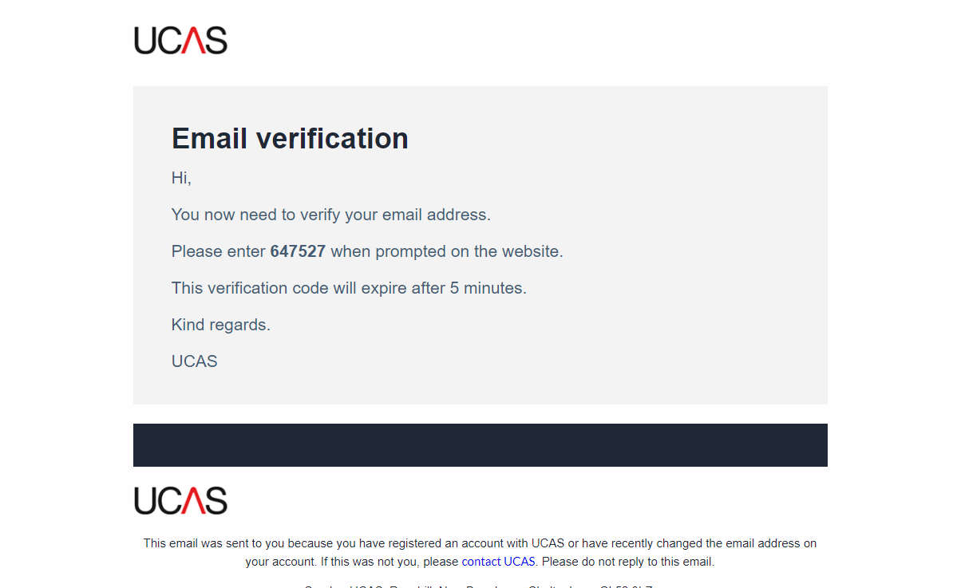
Registering for an account
UCAS will email you a code to verify your email address, so we know we’ve got the right details.

Slide 7
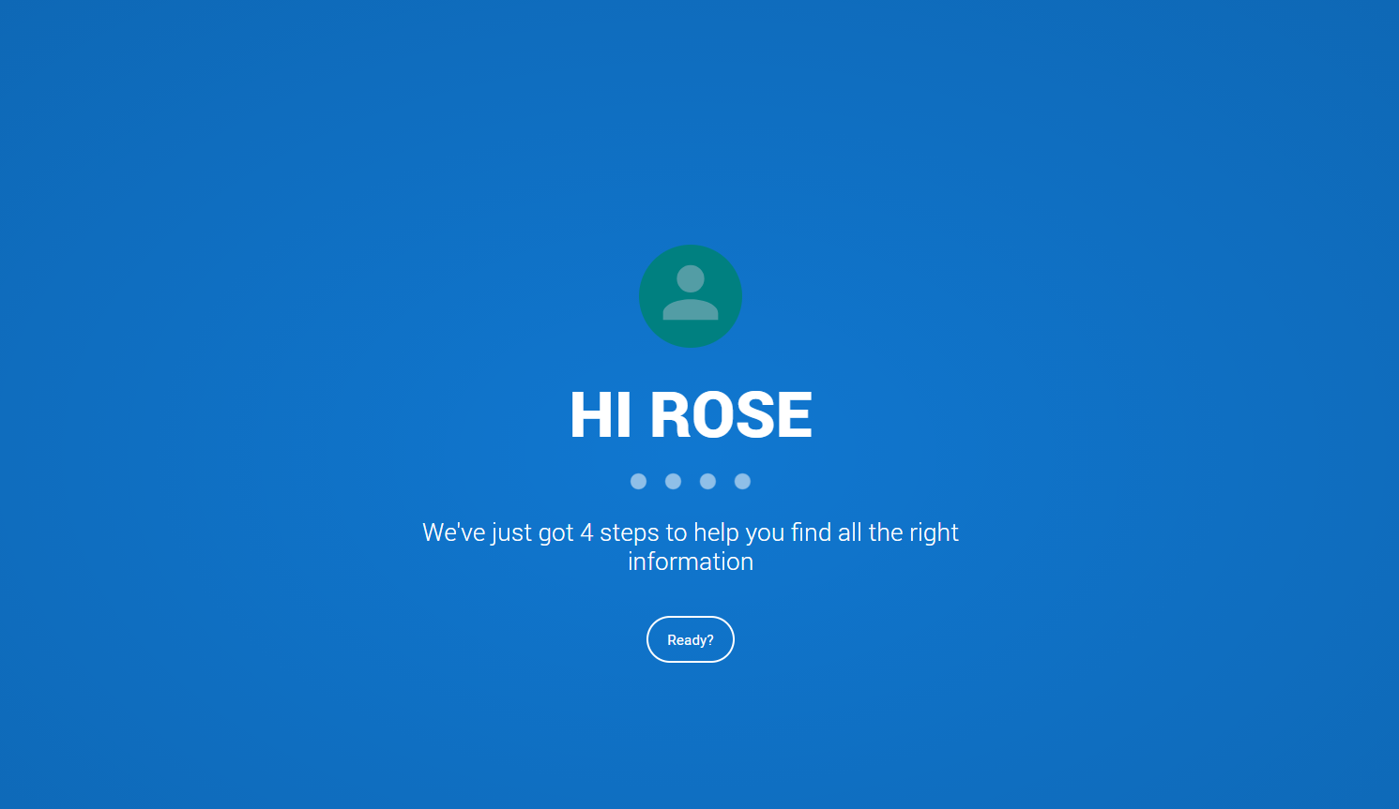
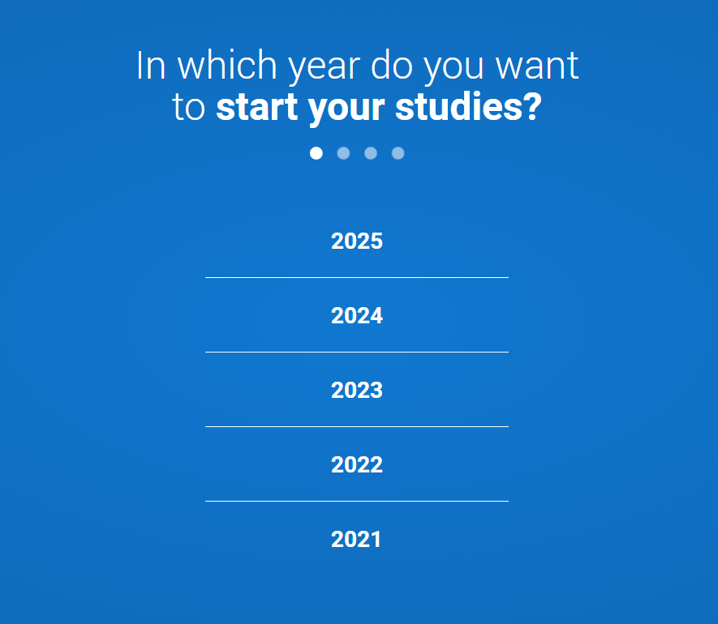
Registering for an account
Once you’ve registered, we ask you a few questions like when you want to start studying, where you live and what you’re interested in so we can tailor the information you see.
Make sure you choose the correct study year, 2023 if you want to start September next year.

Slide 8
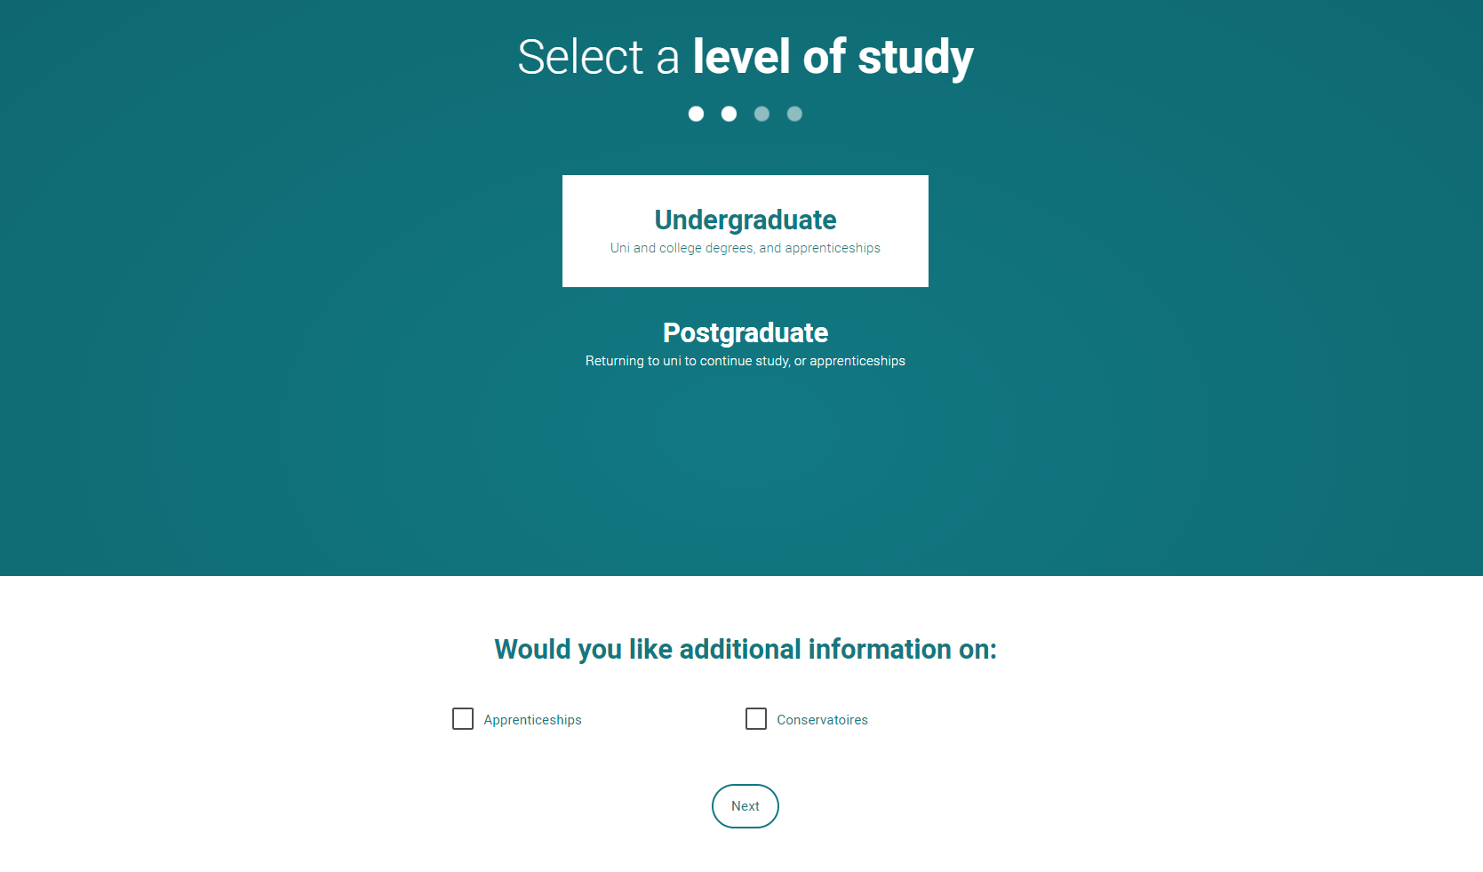
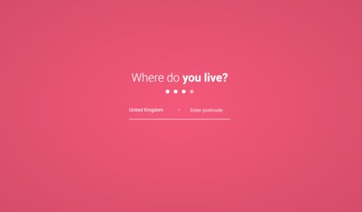
Registering for an account
Choose the correct level of study, it's Undergraduate.
You can choose to get information on apprenticeships and conservatoires here too.
Tell us where you live so we can direct you to the right information.

Slide 9
Registering for an account
Choose if you want to get tailored information about uni, college and apprenticeship options.
Select the subjects that you are interested in – you can change these at any point in your preferences.
Then scroll right to the bottom to Create account.

